Slide 1
Predict gene essentiality For each gene build a model
2020-03-24 Ya Han

Slide 2
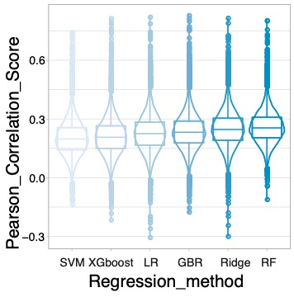
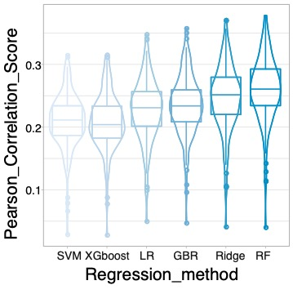
Test 10 correlation features and 10 interaction features with regression methods.
Gene correlation distribution
Sample correlation distribution

Slide 3
Compare the average gene correlation score between all predicted genes and PR genes.

Slide 4
Compare the difference between well predicted and worse predicted genes at following levels:
expression, essential score, variation of expression and essential score.

Slide 5
Train model with multiple genes.
Gene correlation distribution
Sample correlation distribution

